Slide 1
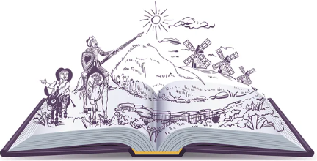

How to revise English Literature

Slide 2


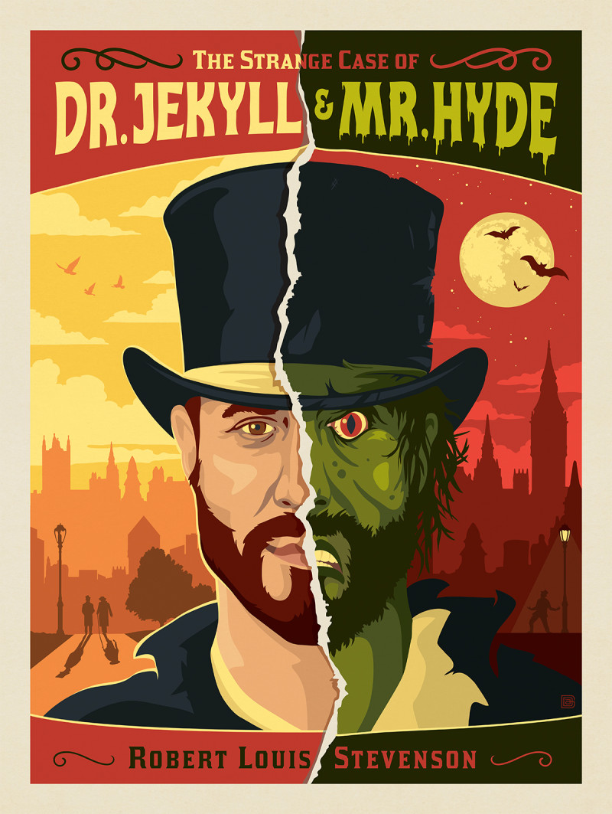
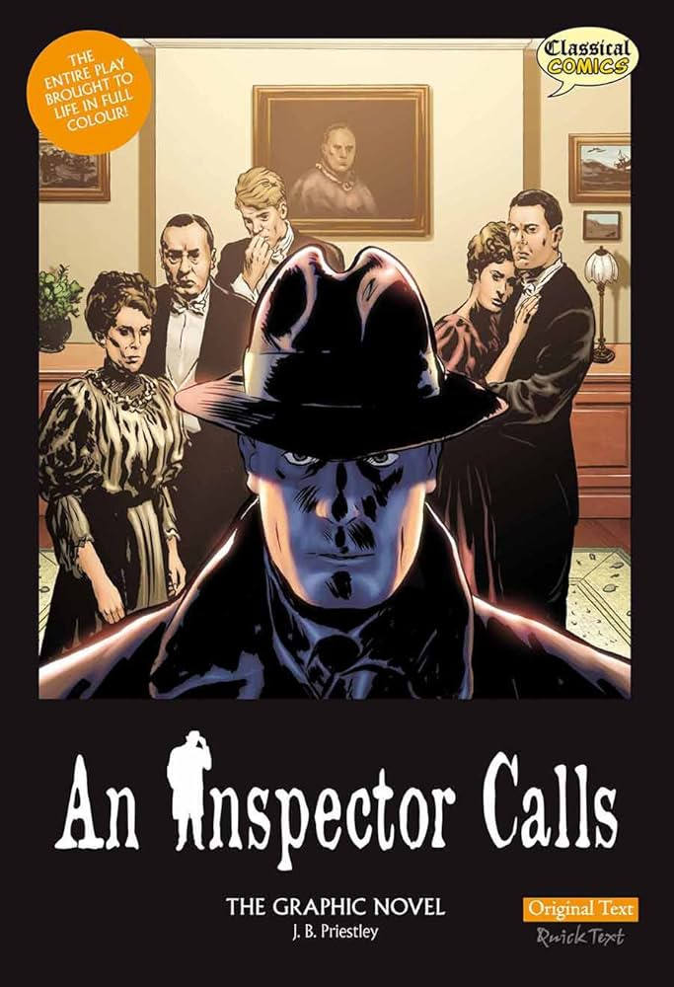
What your child is studying:
A Christmas Carol OR Jekyll and Hyde
An Inspector Calls
Romeo & Juliet
Anthology of “Belonging” Poetry

Slide 3

Over breakfast…
Quote of the day
Ask your child to explain one short quotation
Who says it? What’s happening? Why does it matter?
One Minute Summary
Summarise Act 1 of Romeo & Juliet
Summarise the Poem “Sunday Dip”

Slide 4
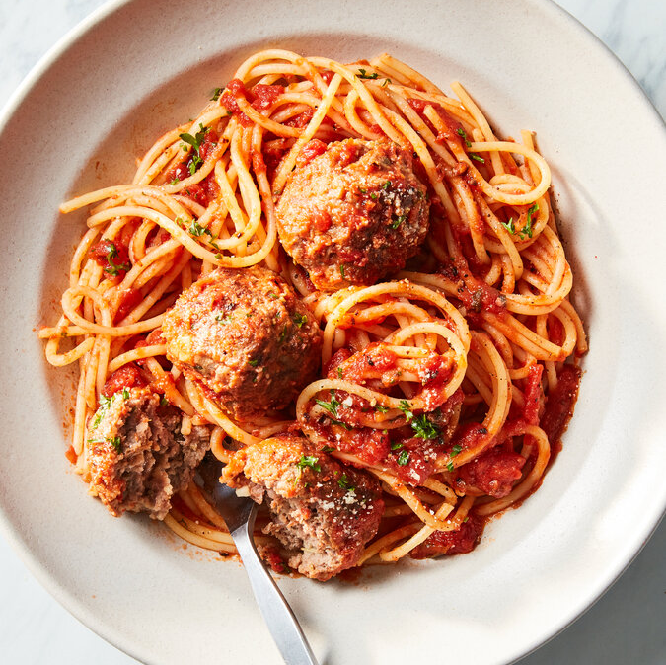
Whilst eating dinner
Teach Me!
Ask your child one of the following:
What are your feelings towards a certain character?
How is this theme shown?

Slide 5
What they can be doing independently?
Revision workbooks
Seneca
Practice Questions (please see past papers on student area)
5 minute plans (your child to mind map how they would respond to a question – quotation, techniques, context. If they can’t think of any, then they can use their resources to help them complete their plan)
Flashcards
Knowledge Organisers

Slide 6
How to revise English Language

Slide 7
Technique Quiz
LANGUAGE
Metaphor
Simile
Personification
Pathetic Fallacy
Semantic field
Alliteration
Sibilance
Noun
Adjective
Verb
Modal verb
Adverb
Onomatopoeia
Oxymoron
STRUCTURE
Rhetorical question
Imperative sentence
Declarative sentence
Interrogative sentence
List of three (triple)
Repetition
Juxtaposition
Punctuation
Paragraph structures

Slide 8

What they can be doing independently?
Revision workbooks
Practice Questions (please see past papers on student area)
5 minute plans (your child to mind map how they would respond to a section B style question)

Slide 9

Thank you!

